Slide 1

QUEUE
ETCS-209: DATA STRUCTURE
ODD SEMESTER 2020

Slide 2
Outline
Operations on a queue
Representation of queue
Multiple queue
Applications of queue
Types of Queue
Linear queue
Circular queue
Priority queue
Deque

Slide 3
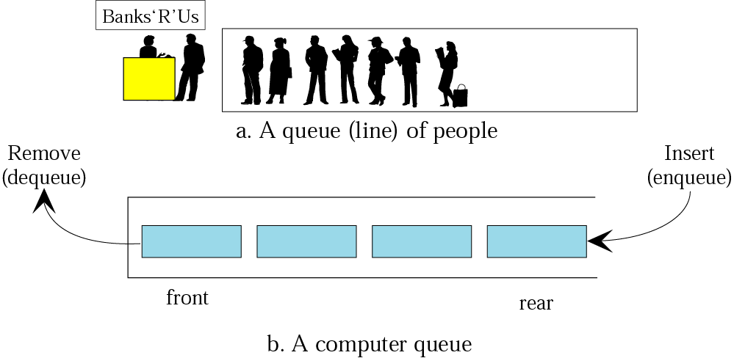
Queue
A queue is a first-in, first-out (FIFO) data structure in which the element that is inserted first is the first one to be taken out.

Slide 4
Queues
The elements in a queue are added at one end called the rear and removed from the other end called the front. Like stacks, queues can be implemented by using either arrays or linked lists.
FIFO
ADT(By array and linked list)
Every queue has front and rear variables that point to the position from where deletions and insertions can be done, respectively. Consider the queue shown in Fig.

Slide 5
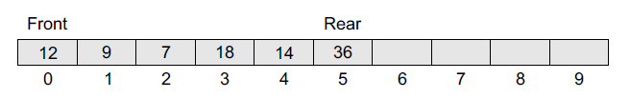
Queues
Here, front = 0 and rear = 5. If we want to add one more value to the list, say, if we want to add another element with the value 45, then the rear would be incremented by 1 and the value would be stored at the position pointed by the rear. The queue, after the addition, would be as shown in Fig.

Slide 6
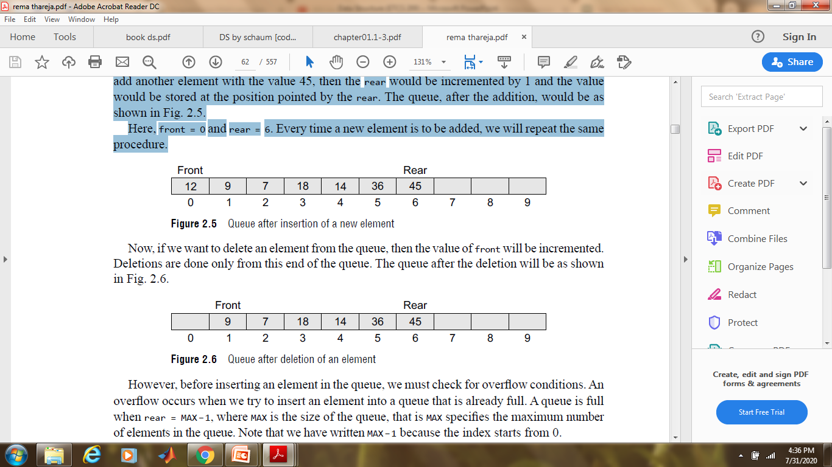
Queues
Here, front = 0 and rear = 6. Every time a new element is to be added, we will repeat the same procedure.

Slide 7
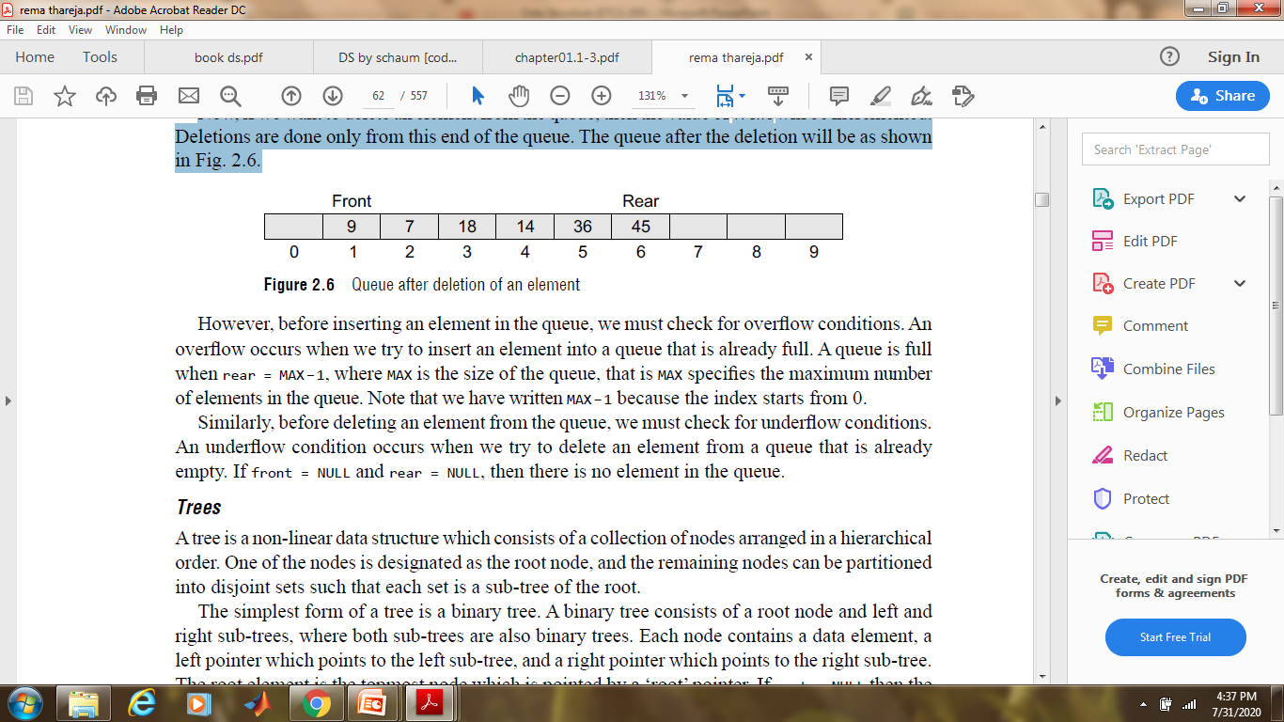
Queues
Now, if we want to delete an element from the queue, then the value of front will be incremented.
Deletions are done only from this end of the queue. The queue after the deletion will be as shown in Fig.

Slide 8
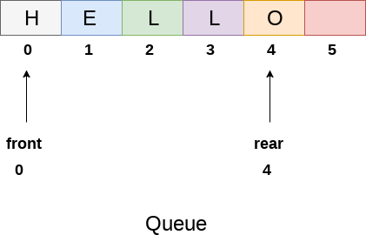
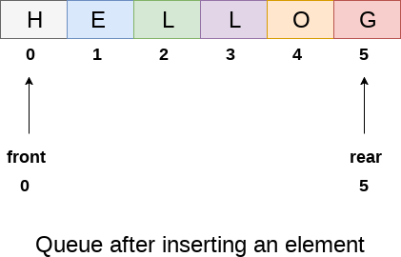
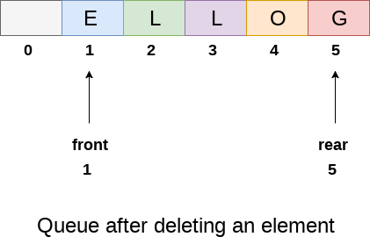

Slide 9
Types of Queues
1.Linear Queue
2.Circular Queue
3.Priority queue
4.Deque

Slide 10
Linear Queue
A queue is an ordered list in which items may be added only at one end called the “rear” and items may be removed only at the other end called “front”.
Operations:
Enqueue: Add an element to the end of the queue
Dequeue: Remove an element from the front of the queue
IsEmpty: Check if the queue is empty
IsFull: Check if the queue is full
Peek: Get the value of the front of the queue without removing it

Slide 11
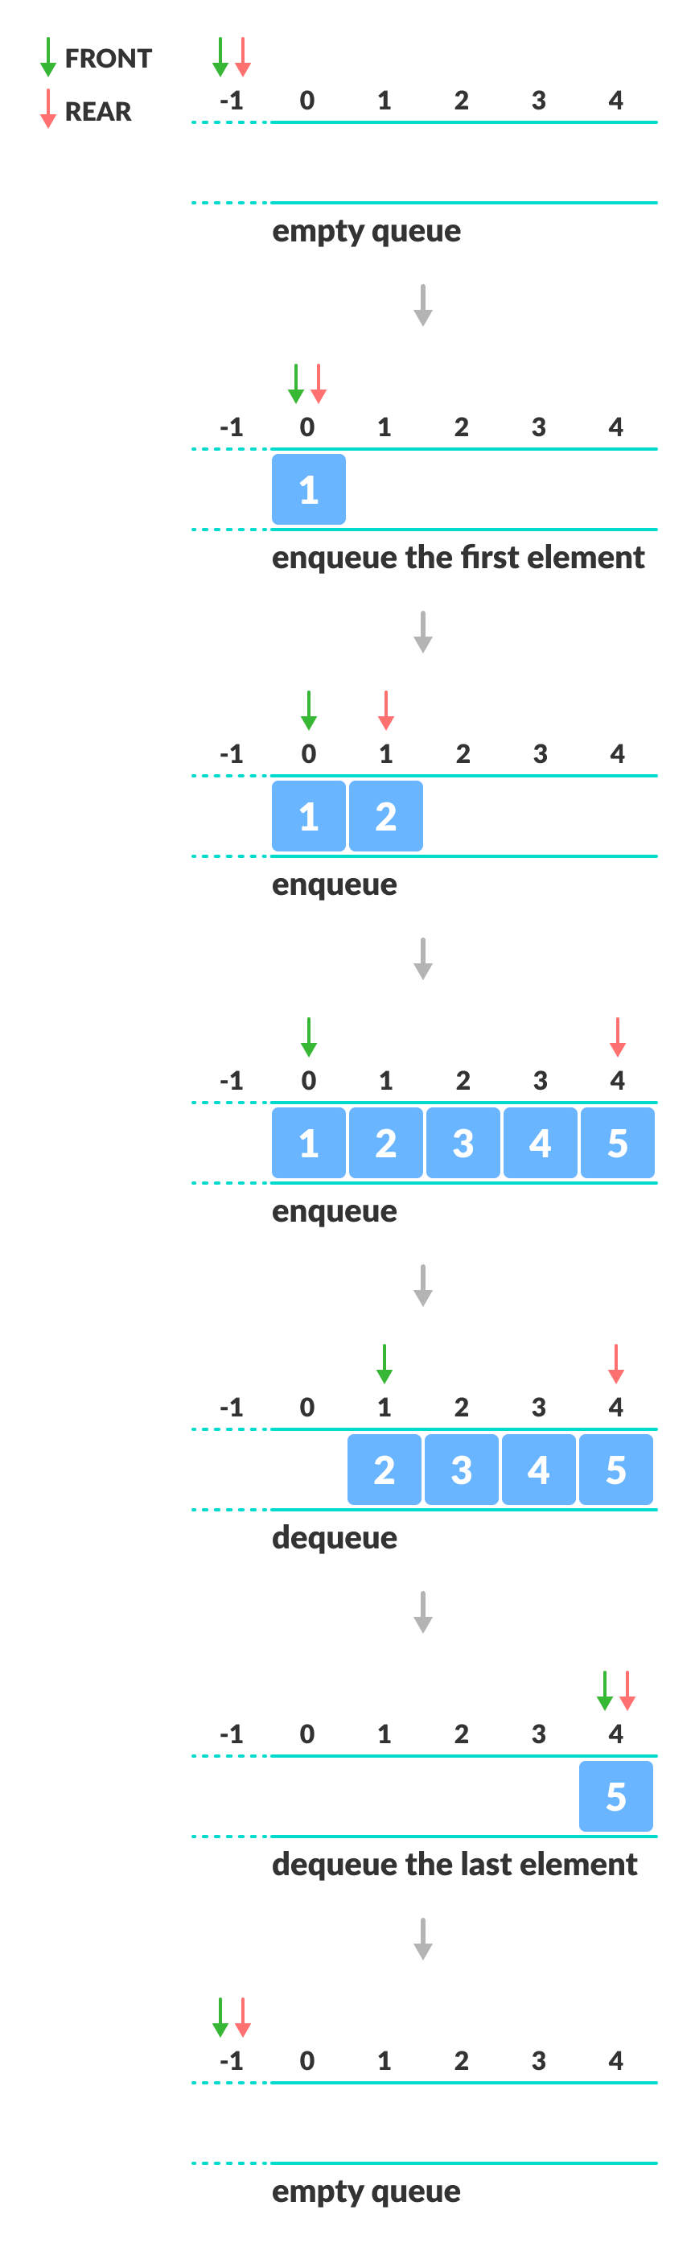
Example

Slide 12
Algorithm to Insert an element in a Linear Queue
Check if the queue is already full by comparing rear to max - 1. if so, then return an overflow error.
If the item is to be inserted as the first element in the list, in that case set the value of front and rear to 0 and insert the element at the rear end.
Otherwise keep increasing the value of rear and insert each element one by one having rear as the index.

Slide 13
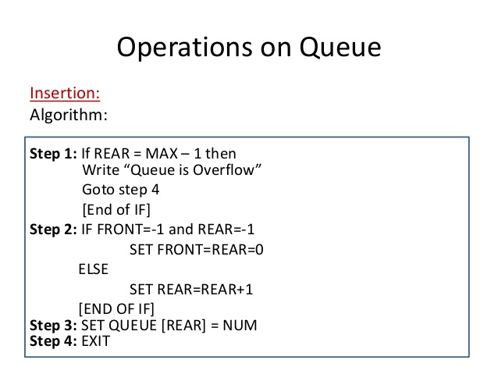

Slide 14
ALGORITHM TO DELETE AN ELEMENT FROM LINEAR QUEUE
int delete (int queue[], int max, int front, int rear)
{
int y;
if (front == -1)
{
printf("underflow");
}
else
{
y = queue[front];
if(front == rear)
{
front = rear = -1;
else
front = front + 1;
}
return y;
}
}

Slide 15
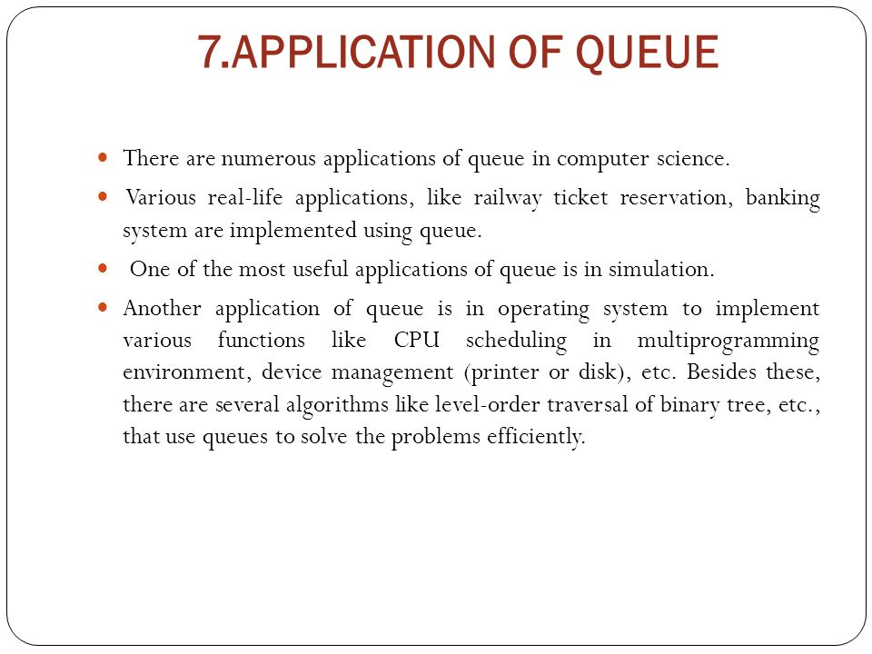

Slide 16
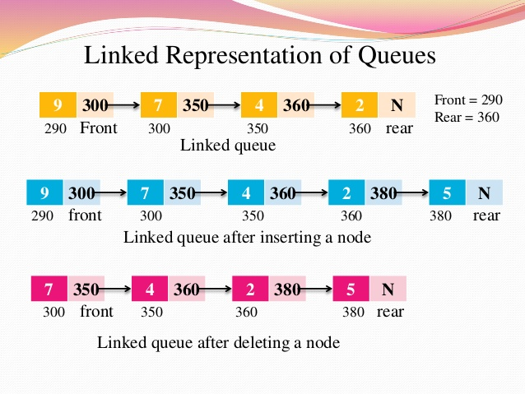
Linked list representation
Insertion at end of linked list
Deletion at beginning

Slide 17
Drawback of Linear Queue
The linear queue suffers from serious drawback that performing some operations, we can not insert items into queue, even if there is space in the queue. Suppose we have queue of 5 elements and we insert 5 items into queue, and then delete some items, then queue has space, but at that condition we can not insert items into queue.

Slide 18
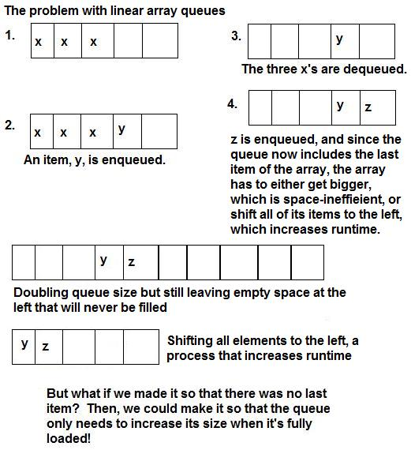
Drawback of Linear Queue

Slide 19
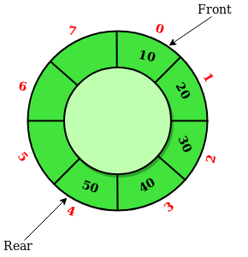
Circular Queue
A circular queue is a linear data structure in which the operations are performed based on FIFO (First In First Out) principle and the last position is connected back to the first position to make a circle. It is also called ‘Ring Buffer’.

Slide 20
Application of Circular Queue
Memory Management: The unused memory locations in the case of ordinary queues can be utilized in circular queues.
Traffic system: In computer controlled traffic system, circular queues are used to switch on the traffic lights one by one repeatedly as per the time set.
CPU Scheduling: Operating systems often maintain a queue of processes that are ready to execute or that are waiting for a particular event to occur. eg. Round robin Scheduling

Slide 21
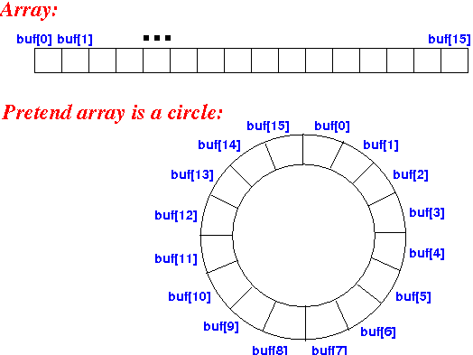
Circular array

Slide 22
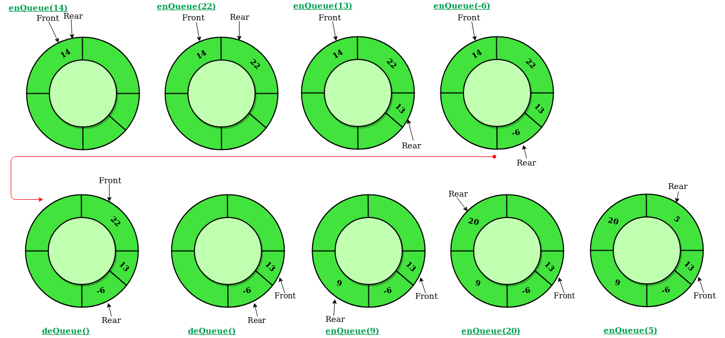

Slide 23
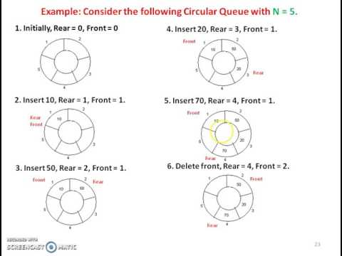

Slide 24
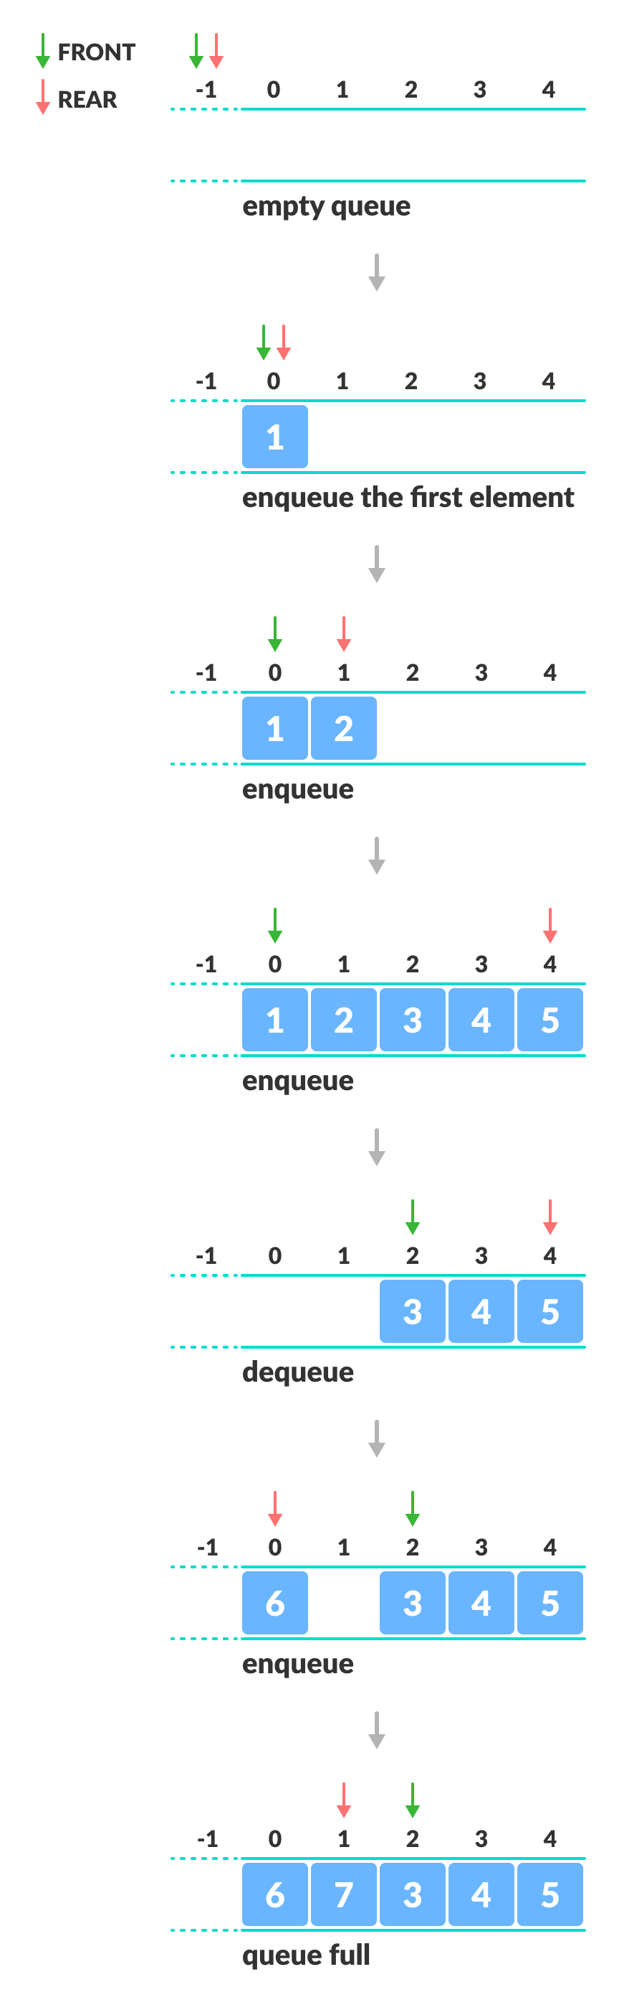
EXAMPLE

Slide 25
conditions
When rear is at last position or rear is equal to MAX-1 then then instead of incrementing rear we reset rear to zero and then perform insertion.
In the same way when front is at the last position of the queue (front == MAX-1) then instead of incrementing front we reset the value of front to 0.

Slide 26
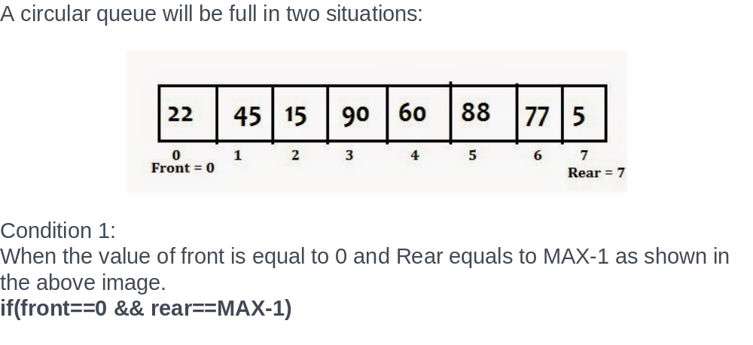
overflow condition
The overflow condition in case of circular queue is different, a circular queue will be full only when all the positions are occupied as opposed to Rear equals to MAX-1 in case of a simple queue.

Slide 27
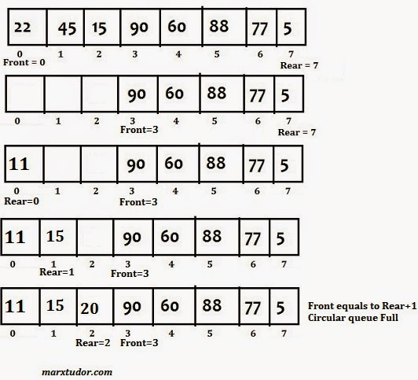
Condition 2:
In the last instance the value of Rear is 2 and Front is 3 which means front = rear + 1
Hence;
if(front==(rear+1) then circular queue is full

Slide 28
Complete overflow condition of the circular queue.
if((front==0 && rear==MAX-1) ||(front==rear+1))
{
printf(“Queue is full”);
}

Slide 29
Insertion in circular array
Step 1: insert(int element)
{
if((front==0 && rear==MAX-1) || (front==rear+1))
{
printf("Queue is fulln");
return;
}
step 2: if(front==-1 and rear==-1)
{
set front =rear= 0;
}
else
if(rear==MAX-1 and front!=0)
{
rear=0;
}
else
{
rear=rear+1;
}
[end of if] step 3: cqueue[rear]=element; }
Notes:
^{<number>}

Slide 30
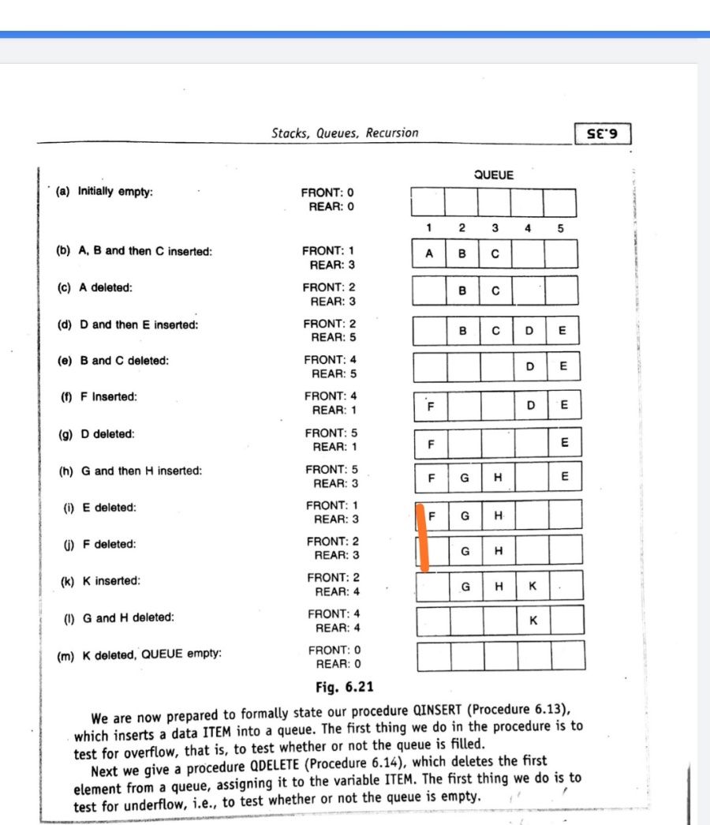
Eg.

Slide 31
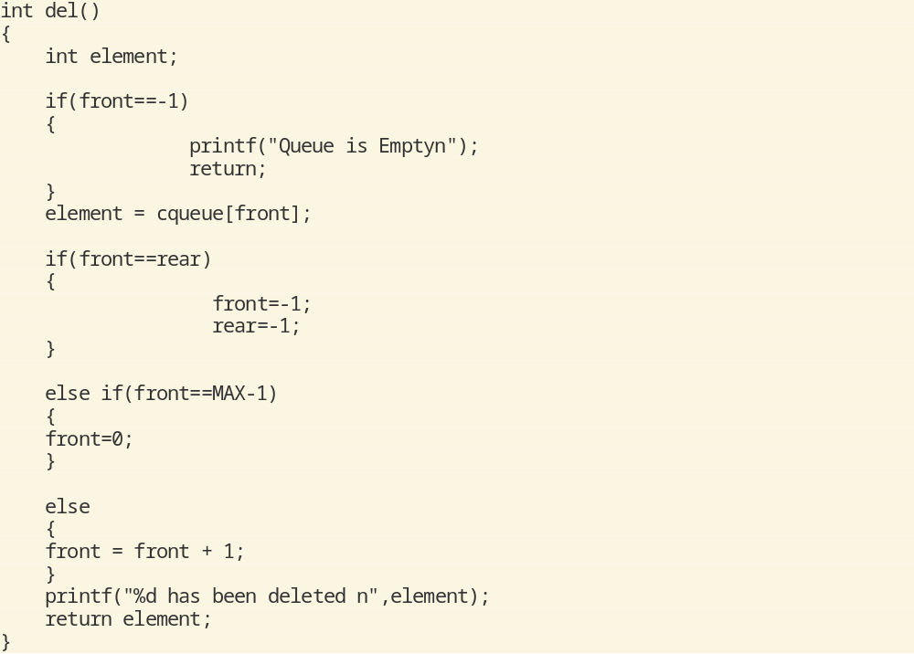
Deletion

Slide 32
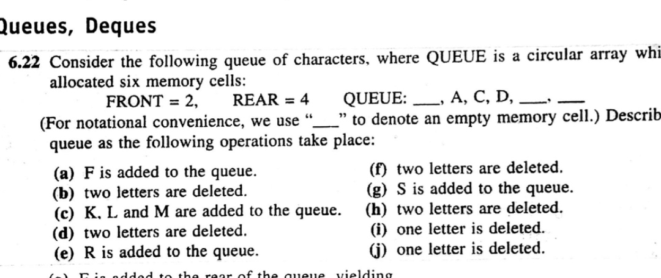
question

Slide 33
PRIORITY QUEUE
A priority queue is a collection of elements such that each element has been assigned a priority and such that the order in which elements are deleted from the following rules:
1.An element of higher priority is processed before an element of lower priority.
2.Two elements with same priority are processed according to the order in which they were added to the queue.

Slide 34
Applications of Priority Queue:
1) CPU Scheduling
2) Graph algorithms like Dijkstra’s shortest path algorithm, Prim’s Minimum Spanning Tree, etc
3) All queue applications where priority is involved.

Slide 35
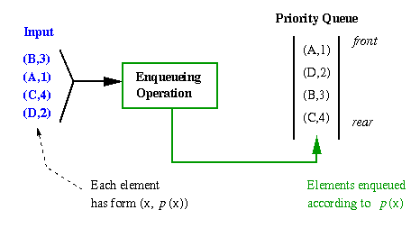

Slide 36
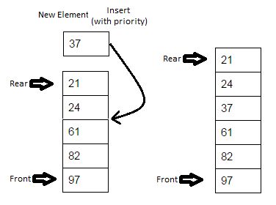
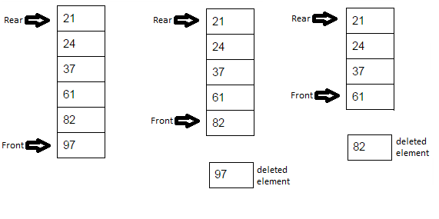

Slide 37
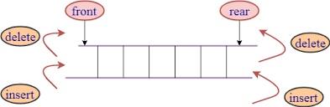
DEQUE
Double ended queue is a more generalized form of queue data structure which allows insertion and removal of elements from both the ends, i.e. , front and rear.

Slide 38
Types of Deque
1.Input Restricted -An input-restricted deque is one where deletion can be made from both ends, but insertion can be made at one end only
2.Output Restricted-An output-restricted deque is one where insertion can be made at both ends, but deletion can be made from one end only.

Slide 39
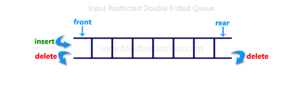
Input Restricted Deque

Slide 40
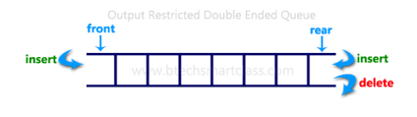
Output Restricted Queue

Slide 41
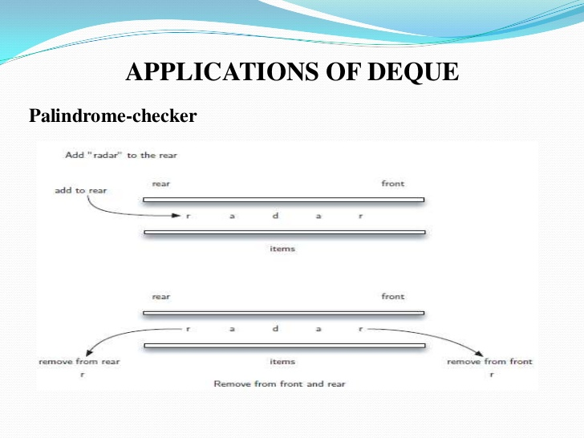
Application of Output Restricted queue

Slide 42
